Slide 1
19th AC-119 Gunship Association Meeting: Oct. 14, 2018
1. Meeting Call to Order – Mike Drzyzga, President
2. Pledge of Allegiance / Prayer by Association Chaplain – “Baby Huey” L. Hunter
3. Welcome All FNGs: Please stand as your name is called (XX!!).
a. Videographer J. P. Mac Isaac - Schedule your interview!!!!!!
b. Reunion Survey – evaluation form
4. Updated Association By-laws
5. Membership Report – Everett Sprous
6. Treasurer Report – Doug Wohlgamuth
7. New AC-119 Gunship Website Report – Wayne Laessig
8. Quartermaster Report – Gus Sininger
9. Newsletter “Firing Circle” Editor - Mike Drzyzga
10. History Book Bio’s/Stories Report – Terry Sarul
11. AC-119 Gunship Facebook Page Administrators Update – Ev Sprous
12. Association Point of Contact (POCs)
13. Legacy Squadrons -- Point of Contact (POCs)
14. Stinger 850 Update – Mike
15 Awards and Decoroations -- ColMac
16. Future Reunions / 2019 Salt Lake City, UT – Chuck Williams/ 2020 REDO- Ohmaha Proposal
17. Election of 2018-19 Board of Directors / Slate of Officers
18. Controlled Chaos – Questions, Comments from the floor
19. Adjourn
Notes:
1
1

Slide 2
Welcome to First Reunion Attendees
Tom Novak, 18th SOS Gunner
John Funk, 18th SOS FE
Levi Rosecrans, 17th SOS Maint
Frank Sledzenski "Ski“, 17th & 18th SOS Gunner
Ken Vath, 17th SOS Maint
Roger Points, 18th SOS Gunner
Bobby New, 18th SOS Maint
Richard Davis, 18th SOS Gunner
John Clark, 17th SOS Gunner
Roy Davis, 17th/18th SOS Pilot
Notes:
2
2

Slide 3
Membership Report -- Ev Sprous
Membership make-up & numbers
Members 2005 2006 2007 2008 2009 2010 2011 2012 2013 2014 2015 2016 2017 2018
Life 192 215 248 275 284 293 306 319 325 342 360 379 389 403
Annual 131 164 153 124 108 97 81 79 73 76 63 56 64 35
Honorary 12 18 18 21 21 22 25 25 28 30 32 31 34 36
Total 335 397 419 420 413 412 412 423 426 448 455 466 487 474
Since Sept 2017, we added 22 new members ( 13 Life & 11 Annual).
“Annual” memberships is starting to decline again!
Total Membership started declining.
Contacts & Newsletter snail-mailing ~$800 E-mailing = $0
Keep your e-mail up to date; we’ll have more $$ to run the Association
Notes:
3
3

Slide 4
Treasurer’s Report -- Doug Wohlgamuth
A. Current Accounts Total Balances = $41,737.99
1. General Account = $36,783.15
2. Quartermaster Account = $4,954.84
B. New AC-119 Gunship Association Website Funds / Expenditures
1. Signed Contract with True World Enterprises (TWE) = $12,750.00
2. Member “Start-Up” Donations at Albuquerque Reunion= $9,887.00
3. AC-119 Association “Ear-Marked” Monies for Website:
2013 San Antonio Reunion = $5,000.00
2014 Albuquerque Reunion = $5,000.00
2015 St. Louis Reunion = $5,000.00
4. Total Payments Made to TWE = $13,195.00
TWE Contract Payments = $8,905.00
Maintenance Payments = $4,200.00
C. Recurring Expenses to the Association:
1. Newsletter Snail-Mail Postage = $800.00 (2015)
2. Teleconference Line = $268.29
3. Pay Pal = $360.00
4. Website Maintenance Fee = $600.00
5. Final Flight Donation: $100.00 per Flight
6. Reunion Advertisements = $300.00
7. Dream Host for Website = $215.68
Notes:
4
4

Slide 5
IT Report New Web site development
Wayne Laessig

Slide 6
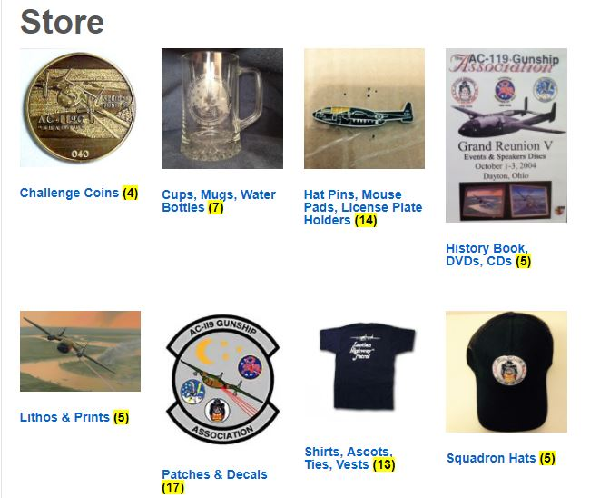
Quartermaster Report – Gus Sininger
1. Using e-commerce section of web-site
2. Adding new items
3. Overhead and shipping COSTs are still increasing.

Slide 7
Firing Circle – Newsletter - Mike Drzyzga
Summary: SEVEN (Nov., Jan., Feb – FLASH re: 73rdSOS, April, May – Flash re: Marshall’s Trike, June, Aug., Sept.)
Content – You tell me (by email) what could be new or refreshing. Provide Feedback Please.
If you send picts to me, please include necessary info.
Future Plan: Same format, keep to 8 pgs or less, double sided, color and B&W
Thank your unit/group POCs for excellent distribution.
PLEASE: NEEDED - a NEW Editor -- computer savvy
Questions?

Slide 8
Active Duty Legacy Squadron POCs
18th FLTS Hurlburt AFB - Gus Sininger
71st SOS Kirtland, CV-22 Osprey - Al Heuss
17th SOS Kadena, OK, MC-130J Commando II --
Don Craig
16th SOS Cannon, AC-130W Stinger II --
Steve MacIsaac & Bob LaRosa
73rd SOS Hurlburt AFB, AC-130J Shadow --
Norm Evans
Notes:
8
8
Intro 73rd guys
73rd Briefing Rooms

Slide 9
Association Points of Contacts (POCs): (Stand-Up)
a. 71st SOS – Jim Alvis
b. 17th SOS – David Voisey
c. 18th SOS – Everett Sprous
d. Maintenance Personnel – Robert “Andy” Bright
e. KIA Families / Outreach / Honorary
– Wayne Laessig
These are your go-to guys to change contact info!!

Slide 10
Upcoming Reunions
1. 2019 – Salt Lake City, TU– Chuck Williams, Sept. 4 – 8, 2019.
2. FUTURE PROPOSALS
a. Explain President goof-up last year for 2020
b. One proposal for Omaha, NE –
John/Laura Wolffe
c. Washington, DC (or Near-by Virginia)
3. Time to work with and pay for a professional “reunion coordinator?”
Awards & Decorations – Col Mac

Slide 11
Nominations & Election of 2017-18 Board Members
President: Mike Drzyzga
Vice President: Bob LaRosa
Secretary: Ralph Lefarth
Membership: Everett Sprous
Treasurer: Doug Wohlgamuth
Past Pres: Larry Fletcher
Member-at-Large: Jim Dunn
Member-at-Large: Cash McCall
Member-at-Large: Terry Sarul
NOTE to New Board: Plan to meet Sunday AFTER TOUR, for an hour or less.
Notes:
11
11

Slide 12
AC-119 Gunship Association Charter
Why do we exist
Old friendships
New Friendships
Get AC-119 into rightful place in History
How do we do that
Web, FB, Db (MCL), Outreach, Legacy Squadrons
$$: Merchandise, Raffles/Auctions, Reunion Dues
History Book & Videotaped sessions
VOLUNTEERS (who can’t continue to do it all)
What do we need to continue to do it well
Sincere and Dedicated people to work.
Notes:
12

