Slide 1
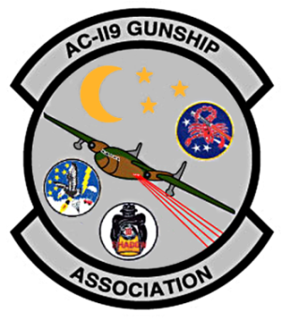
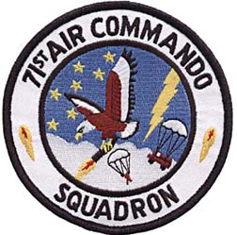
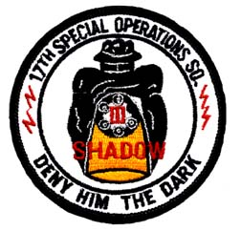
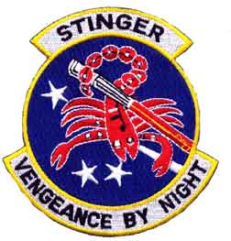
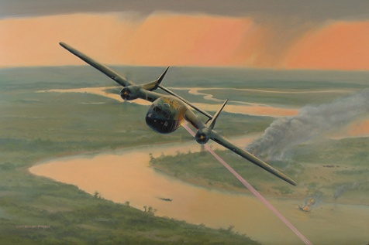
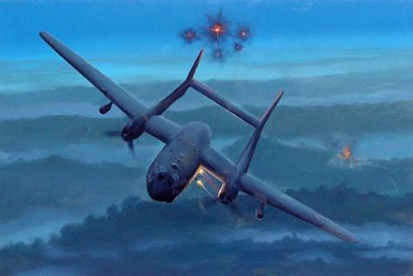
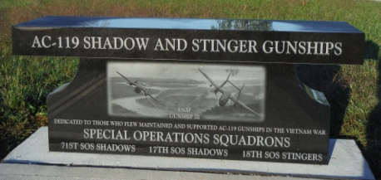
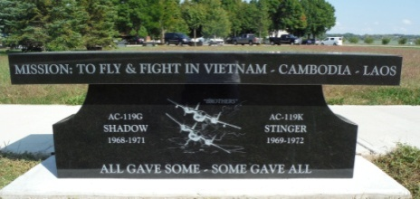
A Brief History of the AC-119 Gunships
In the annals of Vietnam gunship history, the fixed wing AC-47 Puff the Magic Dragon (Spooky, to some) and the AC-130 Spectre gunships were legendary to the combat troops on the ground. But another, seemingly unknown, quieter and deadlier legend emerged in the late 1960s. One that struck a great fear into the hearts of the enemy in Southeast Asia. It was the legend of the fire-spouting dragonships of the 17th and 18th Special Operations Squadrons flying their AC-119G Shadow and AC-119K Stinger gunships.
The fixed-wing gunship was a great developmental and operational success. The basic gunship concept was quite simple: an airplane flying a level turn around a point on the ground (as if tethered to a pylon, hence called a “pylon turn”) can deliver fairly accurate firepower from guns firing perpendicular to the line of flight. For Shadows and Stingers that meant unleashing 3,000 to 6,000 deadly rounds a minute upon the enemy below.
The Gunship concept was used in two very different roles. The first was to provide heavy firepower to ground forces engaged in combat in South Vietnam. This role went to the Shadows of the Air Force Reserve’s 71st Special Operations Squadron who, in 1968, while flying their AC-119G gunships and becoming part of the 14 Special Operations Wing, took up the AC-47’s mission in South Vietnam: defending hamlets, providing fire support for ground troops, and flying close air support and escorting convoys. In 1969, the 71st returned its flag to the United States leaving behind many of its personnel to form a new gunship squadron designated the 17th SOS.
The AC-119K Stingers of the 18th SOS were to interdict enemy logistics in Laos. In 1969, the K model, with the addition of two J85 jet engines, heavier armament (two 20mm guns in addition to the four 7.62 mini-guns), an improved fire control system, and forward looking infrared radar (FLIR), started earning its reputation as one of the most feared truck hunters on the Ho Chi Minh Trail.
Despite heavy antiaircraft and small arms fire, both the AC-119 gunships proved invaluable during the Vietnam War, and fortunately, suffered few losses. A fact directly attributed to the superb airmanship of the gunship crews and fighter escorts, and superb maintenance of their ground crews.
On September 30, 1971, the 14th SOW was deactivated, and by 1973, the war wound down for the Shadow and Stinger squadrons. The AC-119 gunships would fight no more.
The Shadows and Stingers had been a very effective fighting force for the short time they were involved in the Vietnam War. The tremendous advances in technology from those pioneering efforts with the AC-47 nearly 50 years ago made possible the United States Air Force’s successful AC-119 gunship program. Continued advancements have led to the USAF’s present day ultra-sophisticated AC-130 gunship fleet.
For all these unquestionable improvements, however, technical advances can never replace the qualitative link that binds today’s gunship crews, maintenance and support personnel, with those of the legendary Shadow and Stinger Dragonships that once roared as they spat streams of fire from the night skies over Indochina.
Telling Our AC-119 Gunship Story
2017 Reunion Banquet
National Museum
of the
United States Air Force
Wright Patterson AFB Ohio
30 September 2017

Slide 2
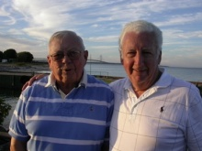
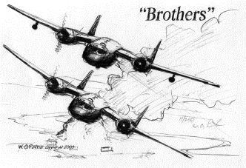
Al Milacek
&
Jim Russell
(2012)
Banquet Program
1820 - Call to seats
1830 - Posting of colors
  Pledge of Allegiance
  POW/MIA
  Invocation
  Dinner
  1925 - Break
  1935- Air Force Ensemble
  2000 - Honorary Membership Presentation
2015 - Keynote Speaker
James A. Russell (LtCol, USAF, Ret.)
2100 - Awards and Recognitions
James A. Russell (LtCol, USAF, Ret.)
Jim Russell was born and raised in Weymouth, Massachusetts. He received a Bachelor of Fine Arts in Product Design from the Massachusetts College of Art (1964). Jim joined the Air Force upon graduation and attended Officer Training School in San Antonio Texas. He completed Navigator Training at Waco AFB, Texas. After receiving his wings, he completed the Instructor Training Program at Randolph AFB, Texas and went directly to Mather AFB, California as a Navigation Instructor. After three years at Mather, he was assigned to Lockbourne AFB, Ohio and the AC-119 Gunship program. Jim deployed a couple of weeks before the first wave from Lockbourne arrived in Viet Nam in November 1969. He escorted a pallet of classified material to Phan Rang. While in Southeast Asia, he flew out of Phan Rang, Phu Cat and Udorn as a FLIR on Al Milacek’s crew and was on the flight that won the Air Force’s Mackay Trophy in 1970. After Vietnam, Jim received a concurrent overseas assignment to Yokota Air Base, Japan with the 556th Reconnaissance Squadron. He flew classified combat missions from Japan, Korea and Vietnam. The Recon squadron was disbanded a year later and he was reassigned to Pope AFB, North Carolina as a Navigator instructor on the C-130 aircraft equipped with the Adverse Weather Aerial Delivery System. While at Pope, Jim deployed to Vietnam on two 4-month rotations as his squadron conducted airdrop missions in Vietnam and Cambodia. Including his Gunship experience, he flew more than 250 combat missions; accumulating over 900 combat hours. Jim also served a tour at HQ MAC and served on a Joint Services Study Group under the Assistant Secretary of Defense for Manpower, Reserve Affairs and Logistics. He completed his career as Commander of AFROTC Detachments at the University of Wisconsin, Superior and the University of Minnesota, Duluth. He retired to Columbus, Ohio, became Mr. Mom, and helped raise their two children as his wife Ann pursued her career as Director of Communications and Director of Planned Giving at Trinity Lutheran Seminary.

