Slide 1
18th AC-119 Gunship Association Meeting: Sept. 30, 2017
I. Meeting Call to Order – Mike Drzyzga, President
II. Pledge of Allegiance / Prayer by Association Chaplain – “Baby Huey” L. Hunter
III. Welcome All FNGs: Please stand as your name is called (XX!!).
a. Videographer J. P. Mac Isaac - Schedule your interview!
b. Reunion Survey – evaluation form
IV. Membership Report – Everett Sprous
V. Treasurer Report – Doug Wohlgamuth
VI. New AC-119 Gunship Website Report – Wayne Laessig
VII. Quartermaster Report – Gus Sininger
VIII. Newsletter “Firing Circle” Editor - Mike Drzyzga
IX. History Book Bio’s/Stories Report – Terry Sarul
X. AC-119 Gunship Facebook Page Administrators Update – Ev Sprous
XI. Association Point of Contact (POCs)
XII. Legacy Squadrons -- Point of Contact (POCs)
XIII. Stinger 850 Update -- Mike
XIV. Future Reunions / 2018 Tucson, AZ – Ev Sprous / 2019 Proposals?
XV. Election of 2017 Board of Directors / Slate of Officers
XVI. VA rep presentation, Dr. J. Thomas Hardy
XVII. Adjourn
Notes:
1
1

Slide 2
Welcome to First Reunion Attendees
71st
Jim Farrell (17th)
Paul Werner, Jr
Jim Kitts
17th
Dennis Harris
Tom Riggs
18th
Windell Bunton
Gene Caruso
Ken Firestone
Larry Mason
Daniel O'Leary
Gary Weaver
456th MMS
Jerry Riesenberg
Notes:
2
2

Slide 3
Membership Report -- Ev Sprous
Membership make-up & numbers
Members 2005 2006 2007 2008 2009 2010 2011 2012 2013 2014 2015 2016 2017
Life 192 215 248 275 284 293 306 319 325 342 360 379 389
Annual 131 164 153 124 108 97 81 79 73 76 63 56 64
Honorary 12 18 18 21 21 22 25 25 28 30 32 31 34
Total 335 397 419 420 413 412 412 423 426 448 455 466 487
Since Sept 2016, we added 24 new members ( 13 Life & 11 Annual).
“Annual” memberships has stopped declining!
Contacts & Newsletter snail-mailing ~$800 E-mailing = $0
Keep your e-mail up to date; we’ll have more $$ to run the Association
Notes:
3
3

Slide 4
Treasurer’s Report -- Doug Wohlgamuth
A. Current Accounts Total Balances = $41,737.99
1. General Account = $36,783.15
2. Quartermaster Account = $4,954.84
B. New AC-119 Gunship Association Website Funds / Expenditures
1. Signed Contract with True World Enterprises (TWE) = $12,750.00
2. Member “Start-Up” Donations at Albuquerque Reunion= $9,887.00
3. AC-119 Association “Ear-Marked” Monies for Website:
2013 San Antonio Reunion = $5,000.00
2014 Albuquerque Reunion = $5,000.00
2015 St. Louis Reunion = $5,000.00
4. Total Payments Made Thus Far to TWE = $13,195.00
TWE Contract Payments = $8,905.00
Maintenance Payments = $4,200.00
C. Recurring Expenses to the Association:
1. Newsletter Snail-Mail Postage = $800.00 (2015)
D. Teleconference Line = $268.29
E. Pay Pal = $360.00
F. Website Maintenance Fee = $600.00
G. Final Flight Donation: $100.00 per Flight
H. Reunion Advertisements = $300.00
I. Dream Host for Website = $215.68
J. AC-119 Gunship Memorial Bench Donations = $1,625.00
1. One-Time “Perpetual Care” at NMUSAF = $500.00
Notes:
4
4

Slide 5
IT Report New Web site development

Slide 6
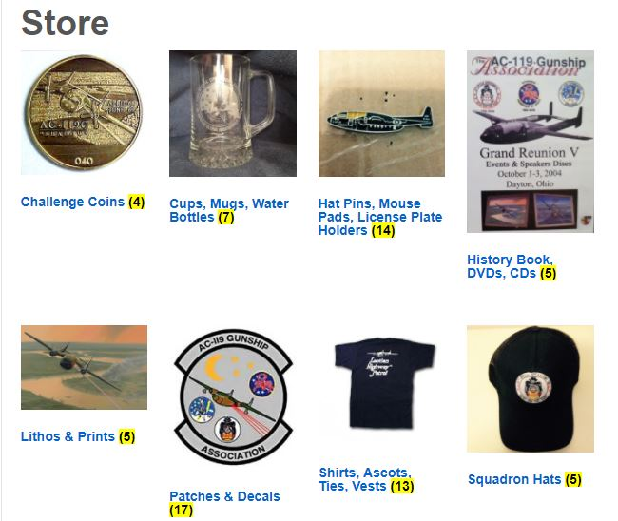
Quartermaster Report – Gus Sininger
1. New e-commerce section of web-site
2. Adding new items
3. Overhead and shipping is increasing.

Slide 7
Firing Circle – Newsletters - Mike Drzyzga
Summary: Six (Nov., Feb., May, July, Aug., Sept.)
Content – You tell me (email) what could be new or refreshing. Feedback Please.
If you send picts to me, please include necessary info.
Future Plan: Same format, keep to 8 pgs or less, double sided, color and B&W
Thank your unit/group POCs for excellent distribution.
PLEASE: NEED a NEW Editor -- PC savvy
Questions?

Slide 8
Active Duty Legacy Squadron POCs
18th FLTS Hurlburt Field - Gus Sininger
71st SOS Kirtland CV-22 Ospreys - Al Heuss
17th SOS Kadena, OK, MC-130J Commando II -
Don Craig
16th (73rd) SOS Cannon AC-130W Ghost Riders -
Mac MacIsaac & Bob LaRosa
Notes:
8
8
Intro 73rd guys
73rd Briefing Rooms

Slide 9
Association Points of Contacts (POCs): (Stand-Up)
a. 71st SOS – Jim Alvis
b. 17th SOS – David Voisey
c. 18th SOS – Everett Sprous
d. Maintenance Personnel – Robert “Andy” Bright
e. KIA Families / Outreach / Honorary
– Wayne Laessig

Slide 10
Upcoming Reunions
1. 2018 – Tucson, AZ – Ev Sprous, Thurs. Oct. 11– Sun. Oct. 14.
2. FUTURE PROPOSALS?? Several with previously expressed interest:
Washington, DC or nearby locale (Virginia?)
Dallas, TX
Las Vegas, NV (Air Fare is very high)
3. Is it time to go for expert “event coordinator” for support – it may cost us?
4. With No Proposal on the floor, this could end at Tucson!

Slide 11
Nominations & Election of 2016-17 Board Members
President: Mike Drzyzga
Vice President: Bob La Rosa
Secretary: Ralph Lefarth
Membership: Everett Sprous
Treasurer: Doug Wohlgamuth
Past Pres: Larry Fletcher
Member-at-Large: Jim Dunn
Member-at-Large: Cash McCall
Member-at-Large: Terry Sarul
NNOTE to New Board: Plan to meet Sunday AFTER TOUR, for an hour.
Notes:
11
11

Slide 12
AC-119 Gunship Association Charter
Why do we exist
Old friendships
New Friendships
Get AC-119 into rightful place in History
How do we do that
Web, FB, Db (MCL), Outreach, Legacy Squadrons
$$: Merchandise, Raffles/Auctions, Reunion Dues
History Book & Videotaped sessions
VOLUNTEERS (who can’t continue to do it all)
What do we need to continue to do it well
Sincere and Dedicated people to work.
Notes:
12

